Slide 1


Slide 2

Best-selling Soccer Simulation Game
260MM+ copies sold world wide
35+ Player Attributes (e.g. Speed, Pace, Agility) contribute to realistic game play
Can these attributes actually determine a player’s success in various league’s across the globe?

Slide 3
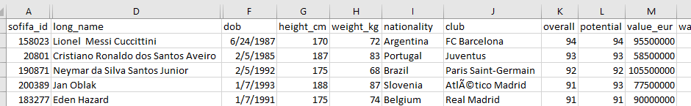
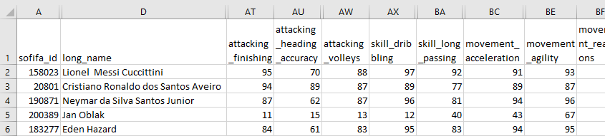
FIFA Player Source Data
Player Info
Player Attributes

Slide 4
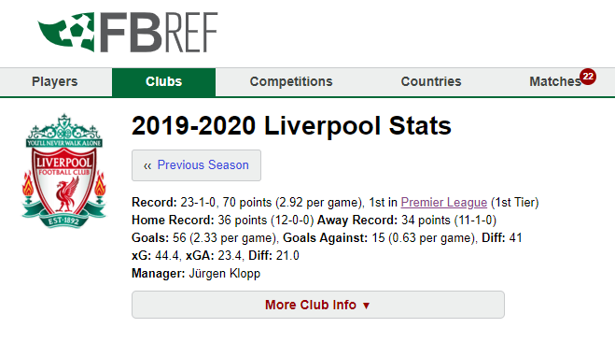
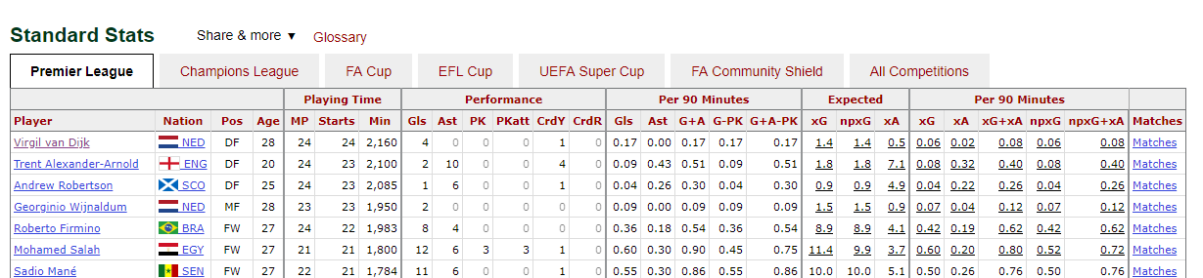
FIFA Player Performance Data
Scraped from fbref.com

Slide 5
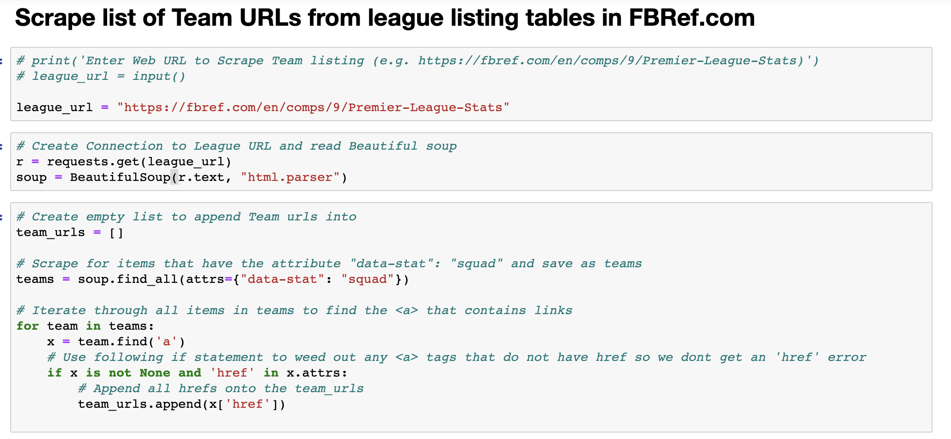
Scrape list of Team URLs from League Page (FBRef.com)
Scraped from fbref.com

Slide 6
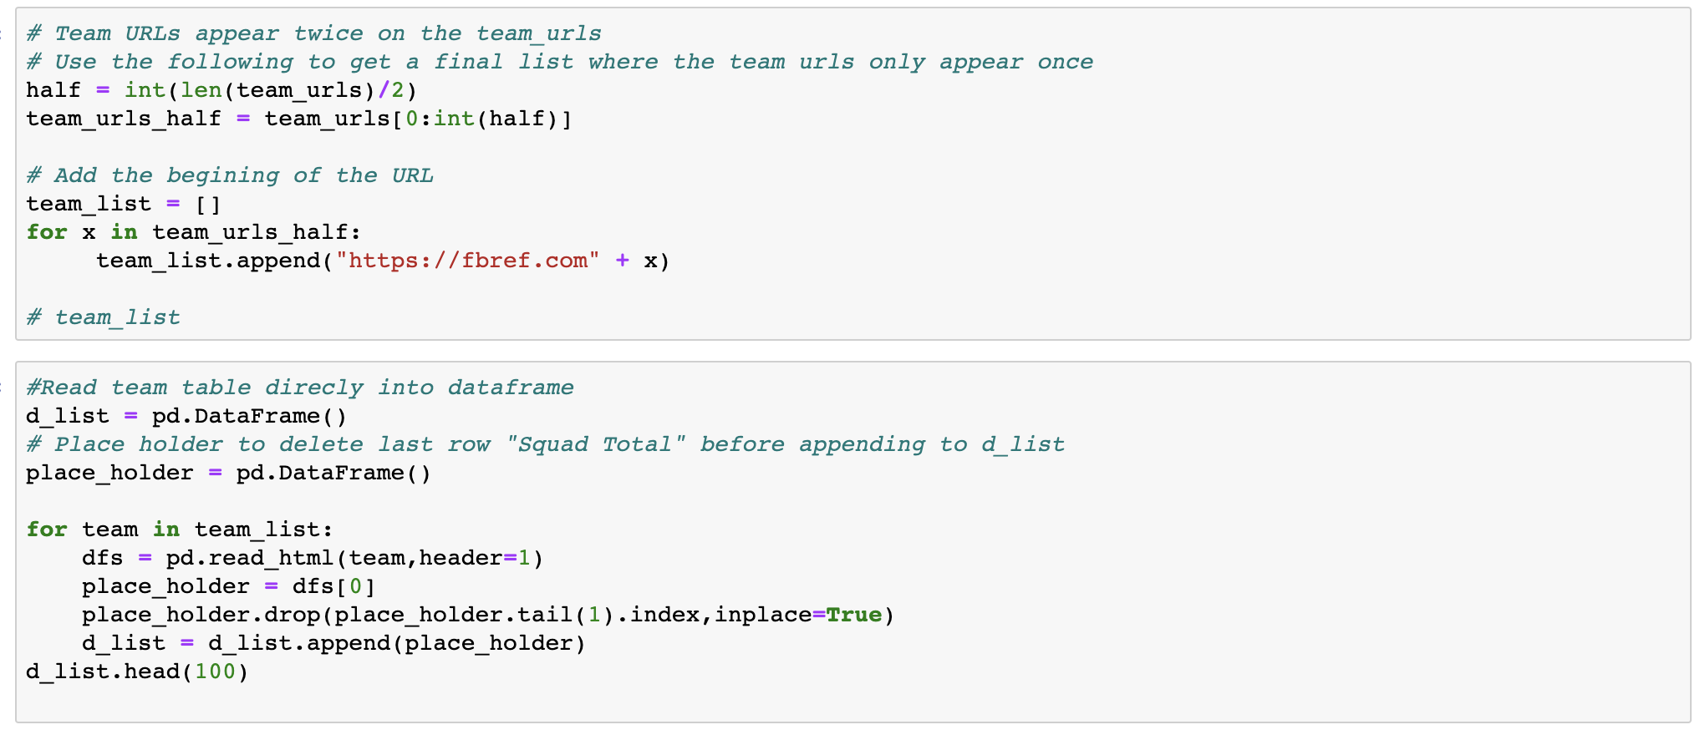
Scrape list of Team URLs from League Page (FBRef.com)
Scraped from fbref.com

Slide 7
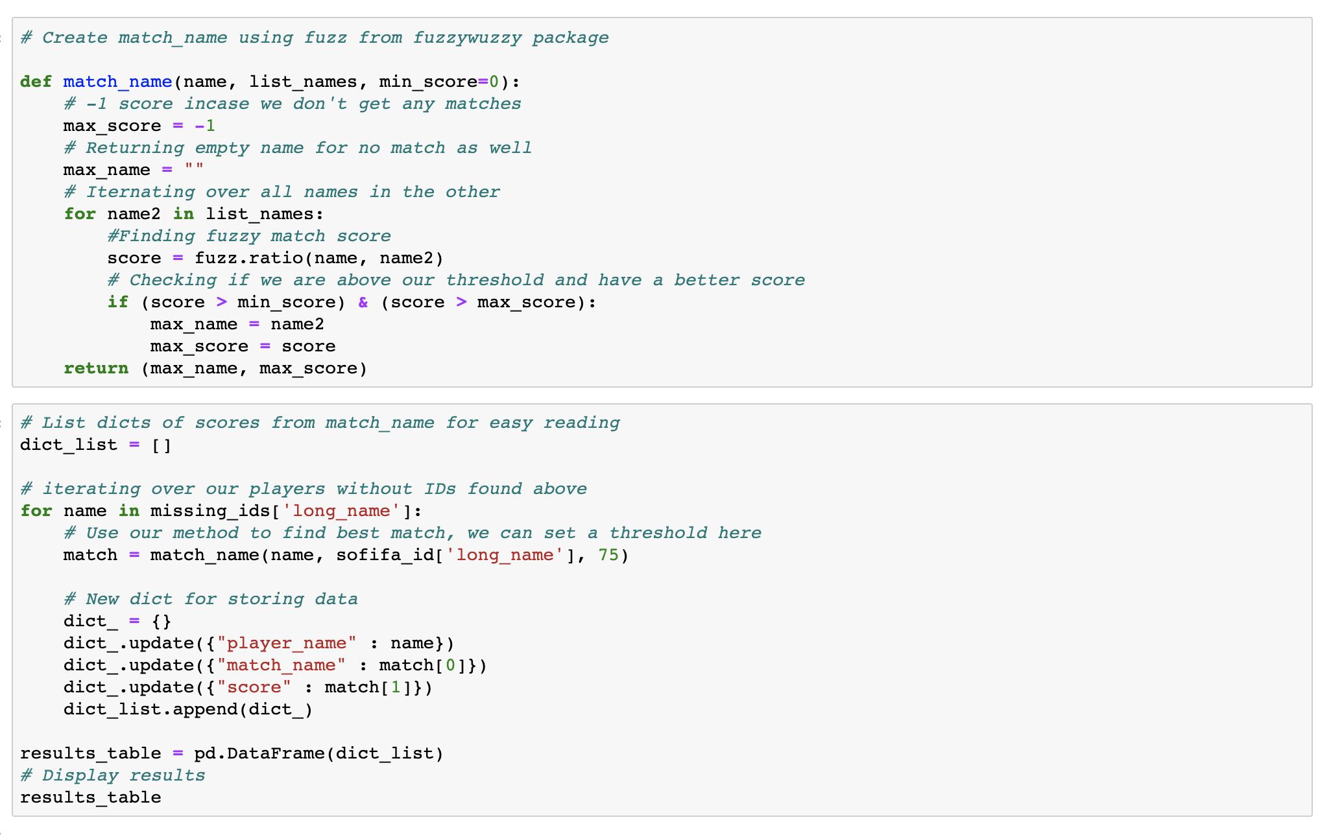
Fuzzy Match

Slide 8
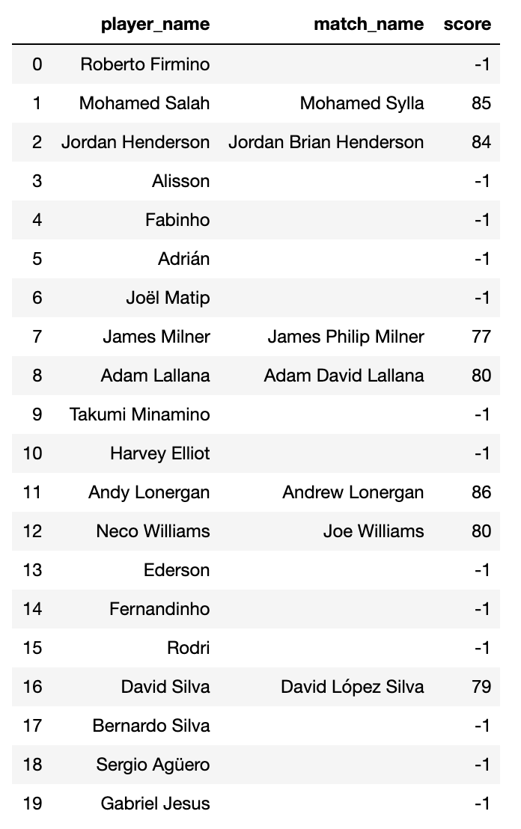
Fuzzy Match Results

Slide 9
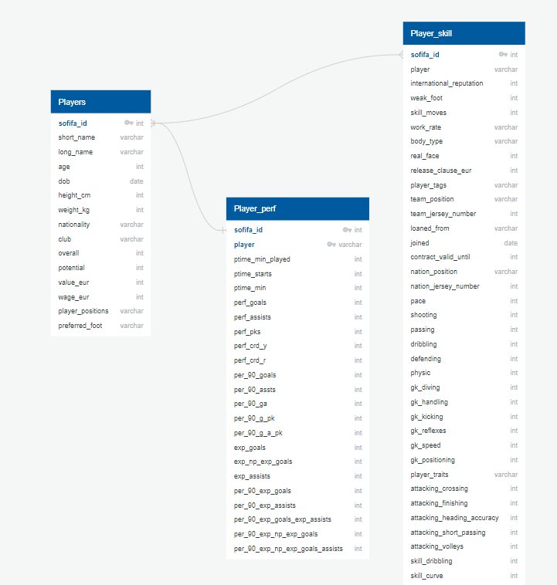
ERD

Slide 10
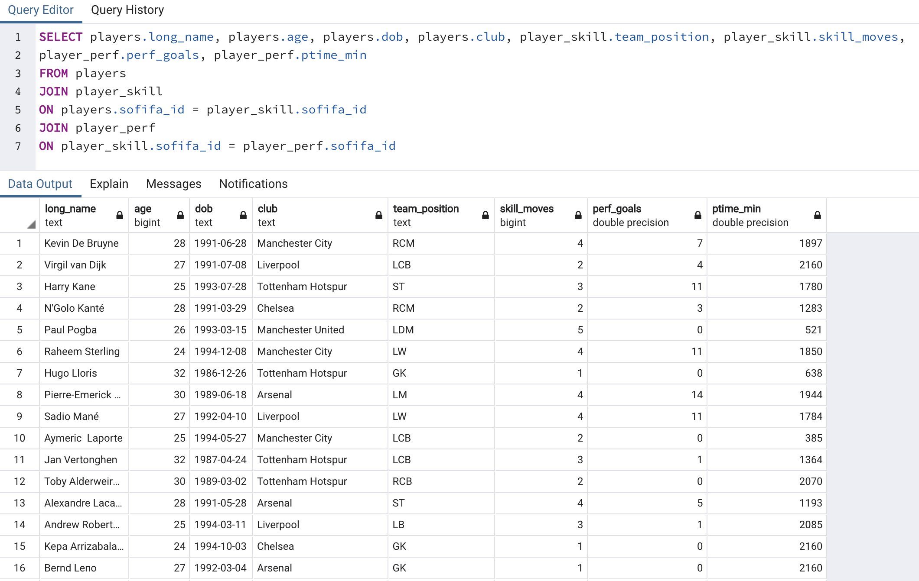
Example of Query

